Slide 1




Ecological Niche Models
Sebastian Fernandez
University of Florida

Slide 2
Ecological Niche
Fundamental Niche
abiotic conditions a species could potentially occupy in the absence of biotic interactions
Realized Niche
abiotic conditions that a species can occupy with the presence of biotic interactions
Fundamental
Niche
Precipitation
Realized
Niche
Temperature
Notes:
A fundamental niche describes the space an organism can inhabit if not for pressures of things like competition, predation and disease
It's what an organism could occupy if they didn’t have to deal with anyone else
Whereas a realized niche is the space an organism actually occupies due to real world pressures
Complex interaction like competition, parasitism, and predation all influence the size of an organism realized niche

Slide 3
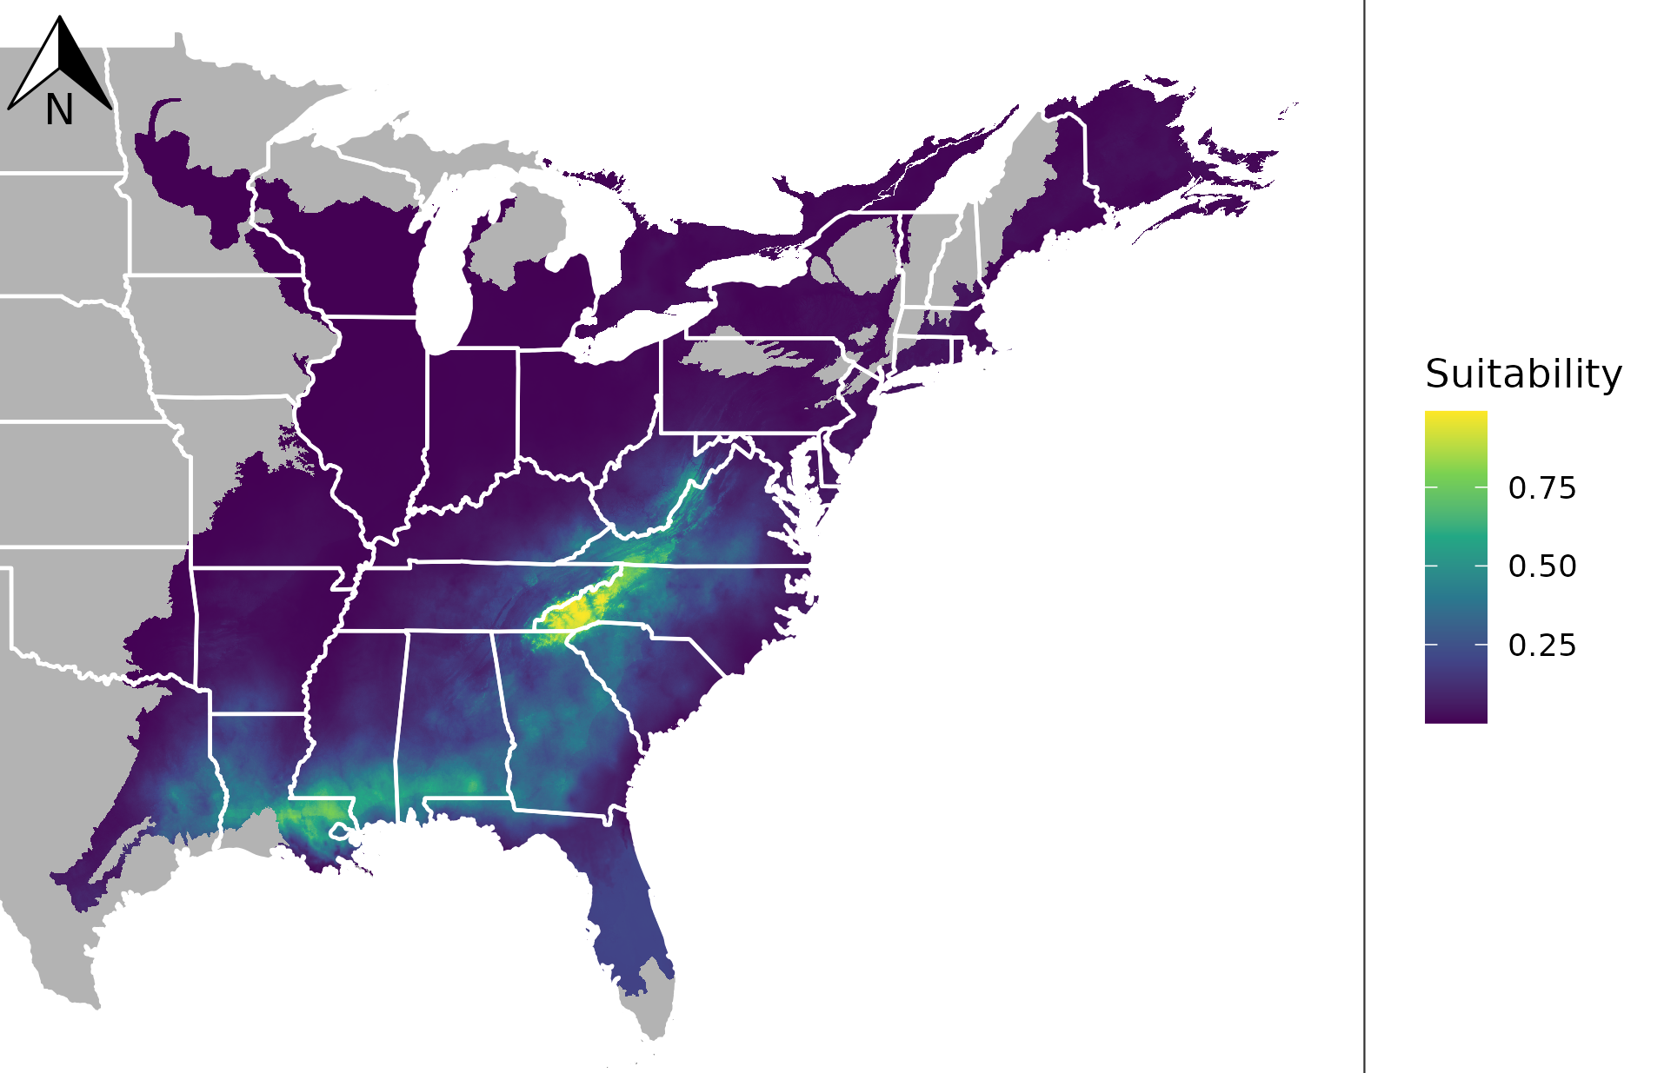




Ecological Niche Modeling
Fundamental Niche
abiotic conditions a species could potentially occupy in the absence of biotic interactions
soil conditions
Niche Modeling Algorithm
elevation
Occupied Space
Notes:
Now, if you’re looking for a way to model those hugely complex, data heavy realized niches, you’re in the wrong workshop because in fact, ecological niche models are predictions of fundamental niches
Taking into account the different environmental pressures acting on an organism, like soil type, climate, and elevation, we can create models that can help visualize an organism's fundamental niche.

Slide 4

Current Observations
Rainfall Suitability Zones
Environmental Data
Altitude Suitability Zones
Notes:
ENMs are basically built of off correlations between environmental conditions where species occur
In this example we can see that our species typically occur in cells of both suitable altitude and rainfall conditions,

Slide 5
Current Observations
Rainfall Suitability Zones
Environmental Data
Altitude Suitability Zones
Notes:
but, importantly, there are suitable areas where the species don’t occur

Slide 6


Current Observations
Habitat model based on current observations, suitable rainfall, and suitable altitude zones
Rainfall Suitability Zones
Environmental Data
Unsuitable Prediction
Suitable Prediction
Altitude Suitability Zones
Notes:
If these cells have adequate suitability for both rainfall and altitude, our models will recognize that and predict them as places our species would find suitable

Slide 7
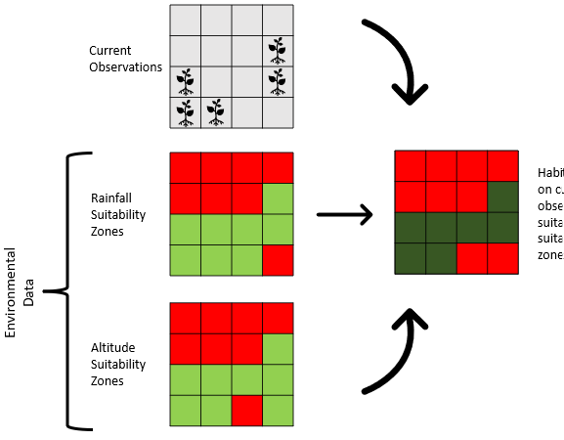
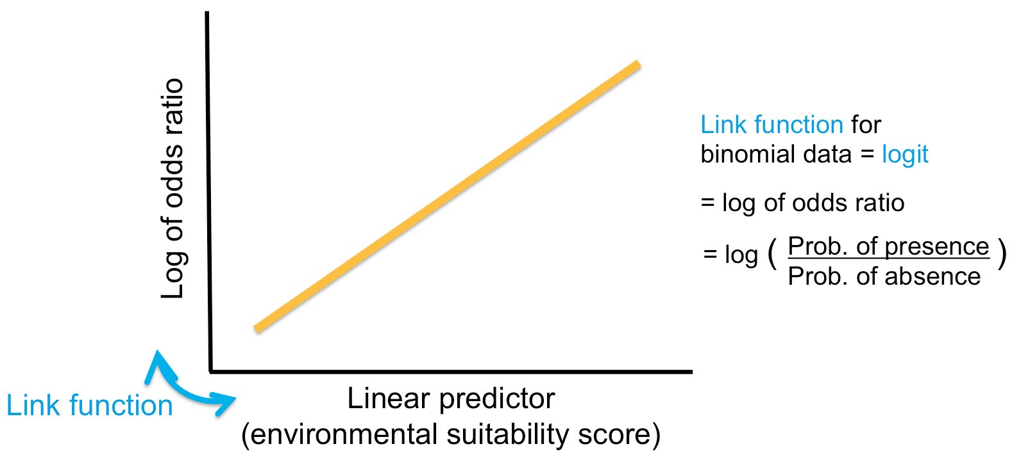
Niche Modeling Algorithms
Generalized Linear Model
Random Forest Analysis
Maxent
Requires absence data
Requires absence data
Does not require absence data
Generalized linear model (GLM) SDM explained. Biosecurity Commons Support Portal. (2023). https://support.biosecuritycommons.org.au/support/solutions/articles/6000262275-generalized-linear-model-glm-sdm-explained
Notes:
Now I want to emphasize that are numerous ways to generate environmental niche models
There are methods like Generalized Linear Models (GLMS), or Random forest analysis but for the purposes of this workshop we’re focusing on maxent. How does it differ? Well…

Slide 8
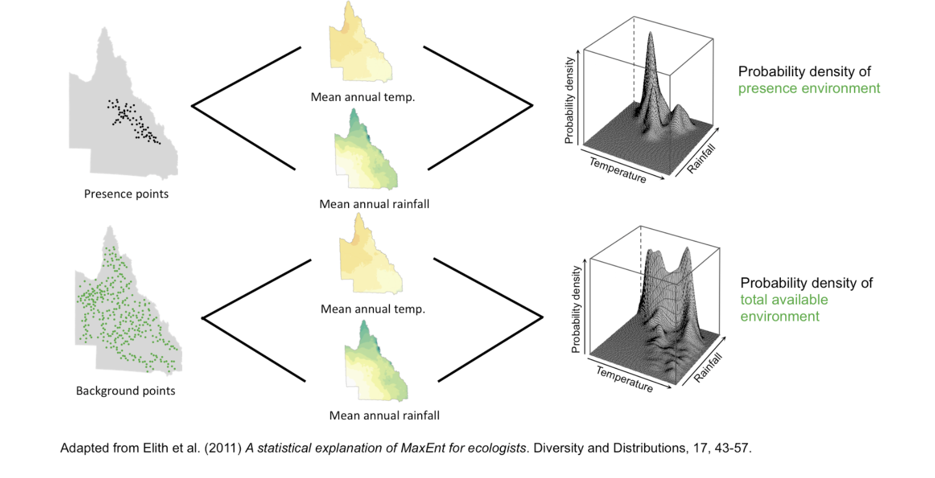
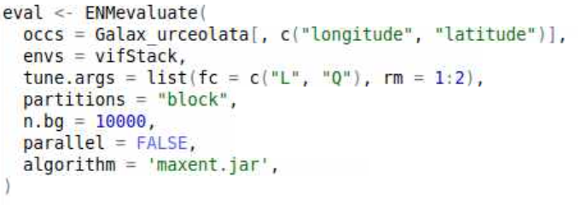
Background Points
Maxent only uses presence data and the algorithm compares the locations of where a species has been found to all the environments that are available in the study region.
Most niche modeling algorithms use presence data to weigh the influence of environmental conditions
Background points define the available environment
Background points can include areas where species occur
Maxent then calculates the ratio between these two probability densities, which gives the relative environmental suitability for presence of a species for each point in the study area.
Notes:
Presence and background points!
Most niche modeling algorithms use presence data to weigh the influence of environmental conditions
If there’s a large density of occurrences or presences in area with, lets say a lot of rain, the influence of precipitation on the models suitability score increases
This influence is then weighted against a randomly sampled collection of points from across the study extent, these are background points
Background points define the available environment
We want to see how influential these environmental conditions are on the fundamental nice of our species, relative to this environment
The more background points we include, the more robust our baseline
By comparing the probability density of our presences with that of our background, our models can get a baseline idea of how influential certain environmental variables are on a species suitability

Slide 9
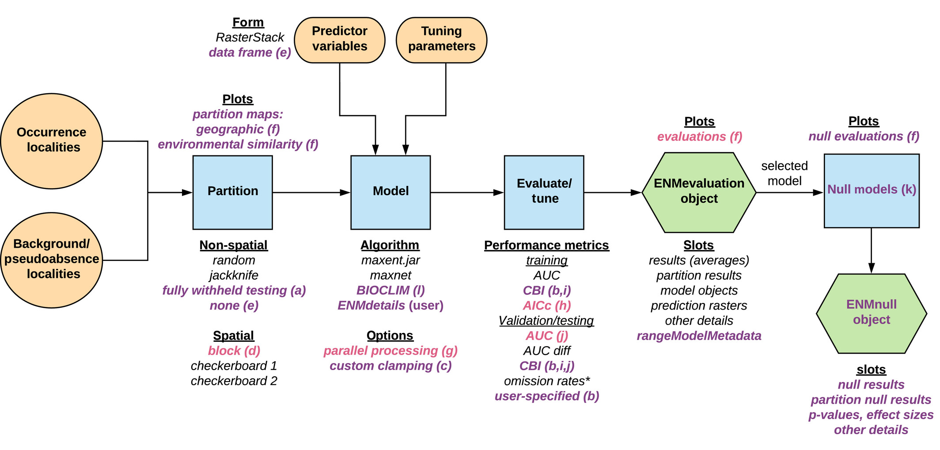
ENMeval
Metrics
Feature Class
Regularization Multiplier
Method
Block
Algorithm
Maxent
Model Testing:
AUC
OM
Data Input
Model Creation
Model Evaluation
Notes:
Now to actually create, fine tune, and evaluate our ecological niche models we use an R package called ENMeval.
By feeding it our occurrence data, background points, and environmental layers we can automatically create dozens of different ENMs all with different model tuning settings
Then, we can evaluate each model to find the optimal one for projecting our species suitability

Slide 10
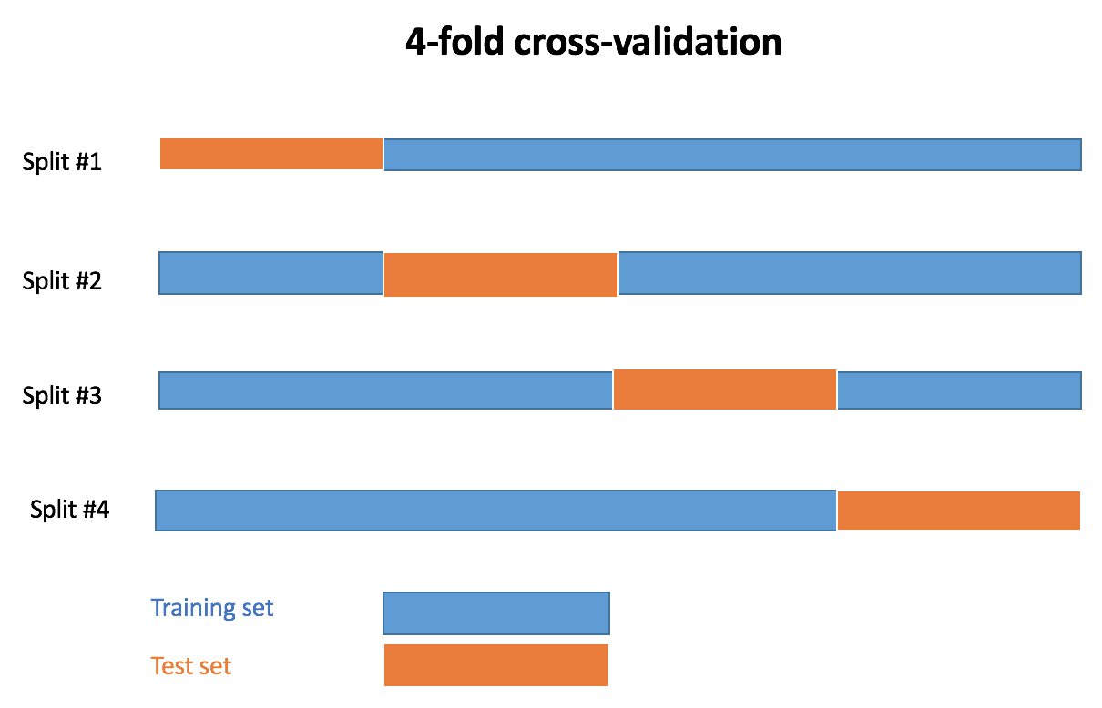
ENMeval: Partitions
Cross validation
a resampling procedure used to evaluate machine learning models on a limited data sample.
Model trained on three blocks and tested on the fourth
Process rotates between blocks
Notes:
A large part of model creation relates to the training and evaluation of a model using cross validation
For all the species we have today we’re going to be using a block partitioning method which will separate our study extent into 4 spatial blocks.
The model is trained on 3 of them and then tested on the fourth.
This process rotates so that each block is used once for testing, this is known as 4 fold cross validation

Slide 11
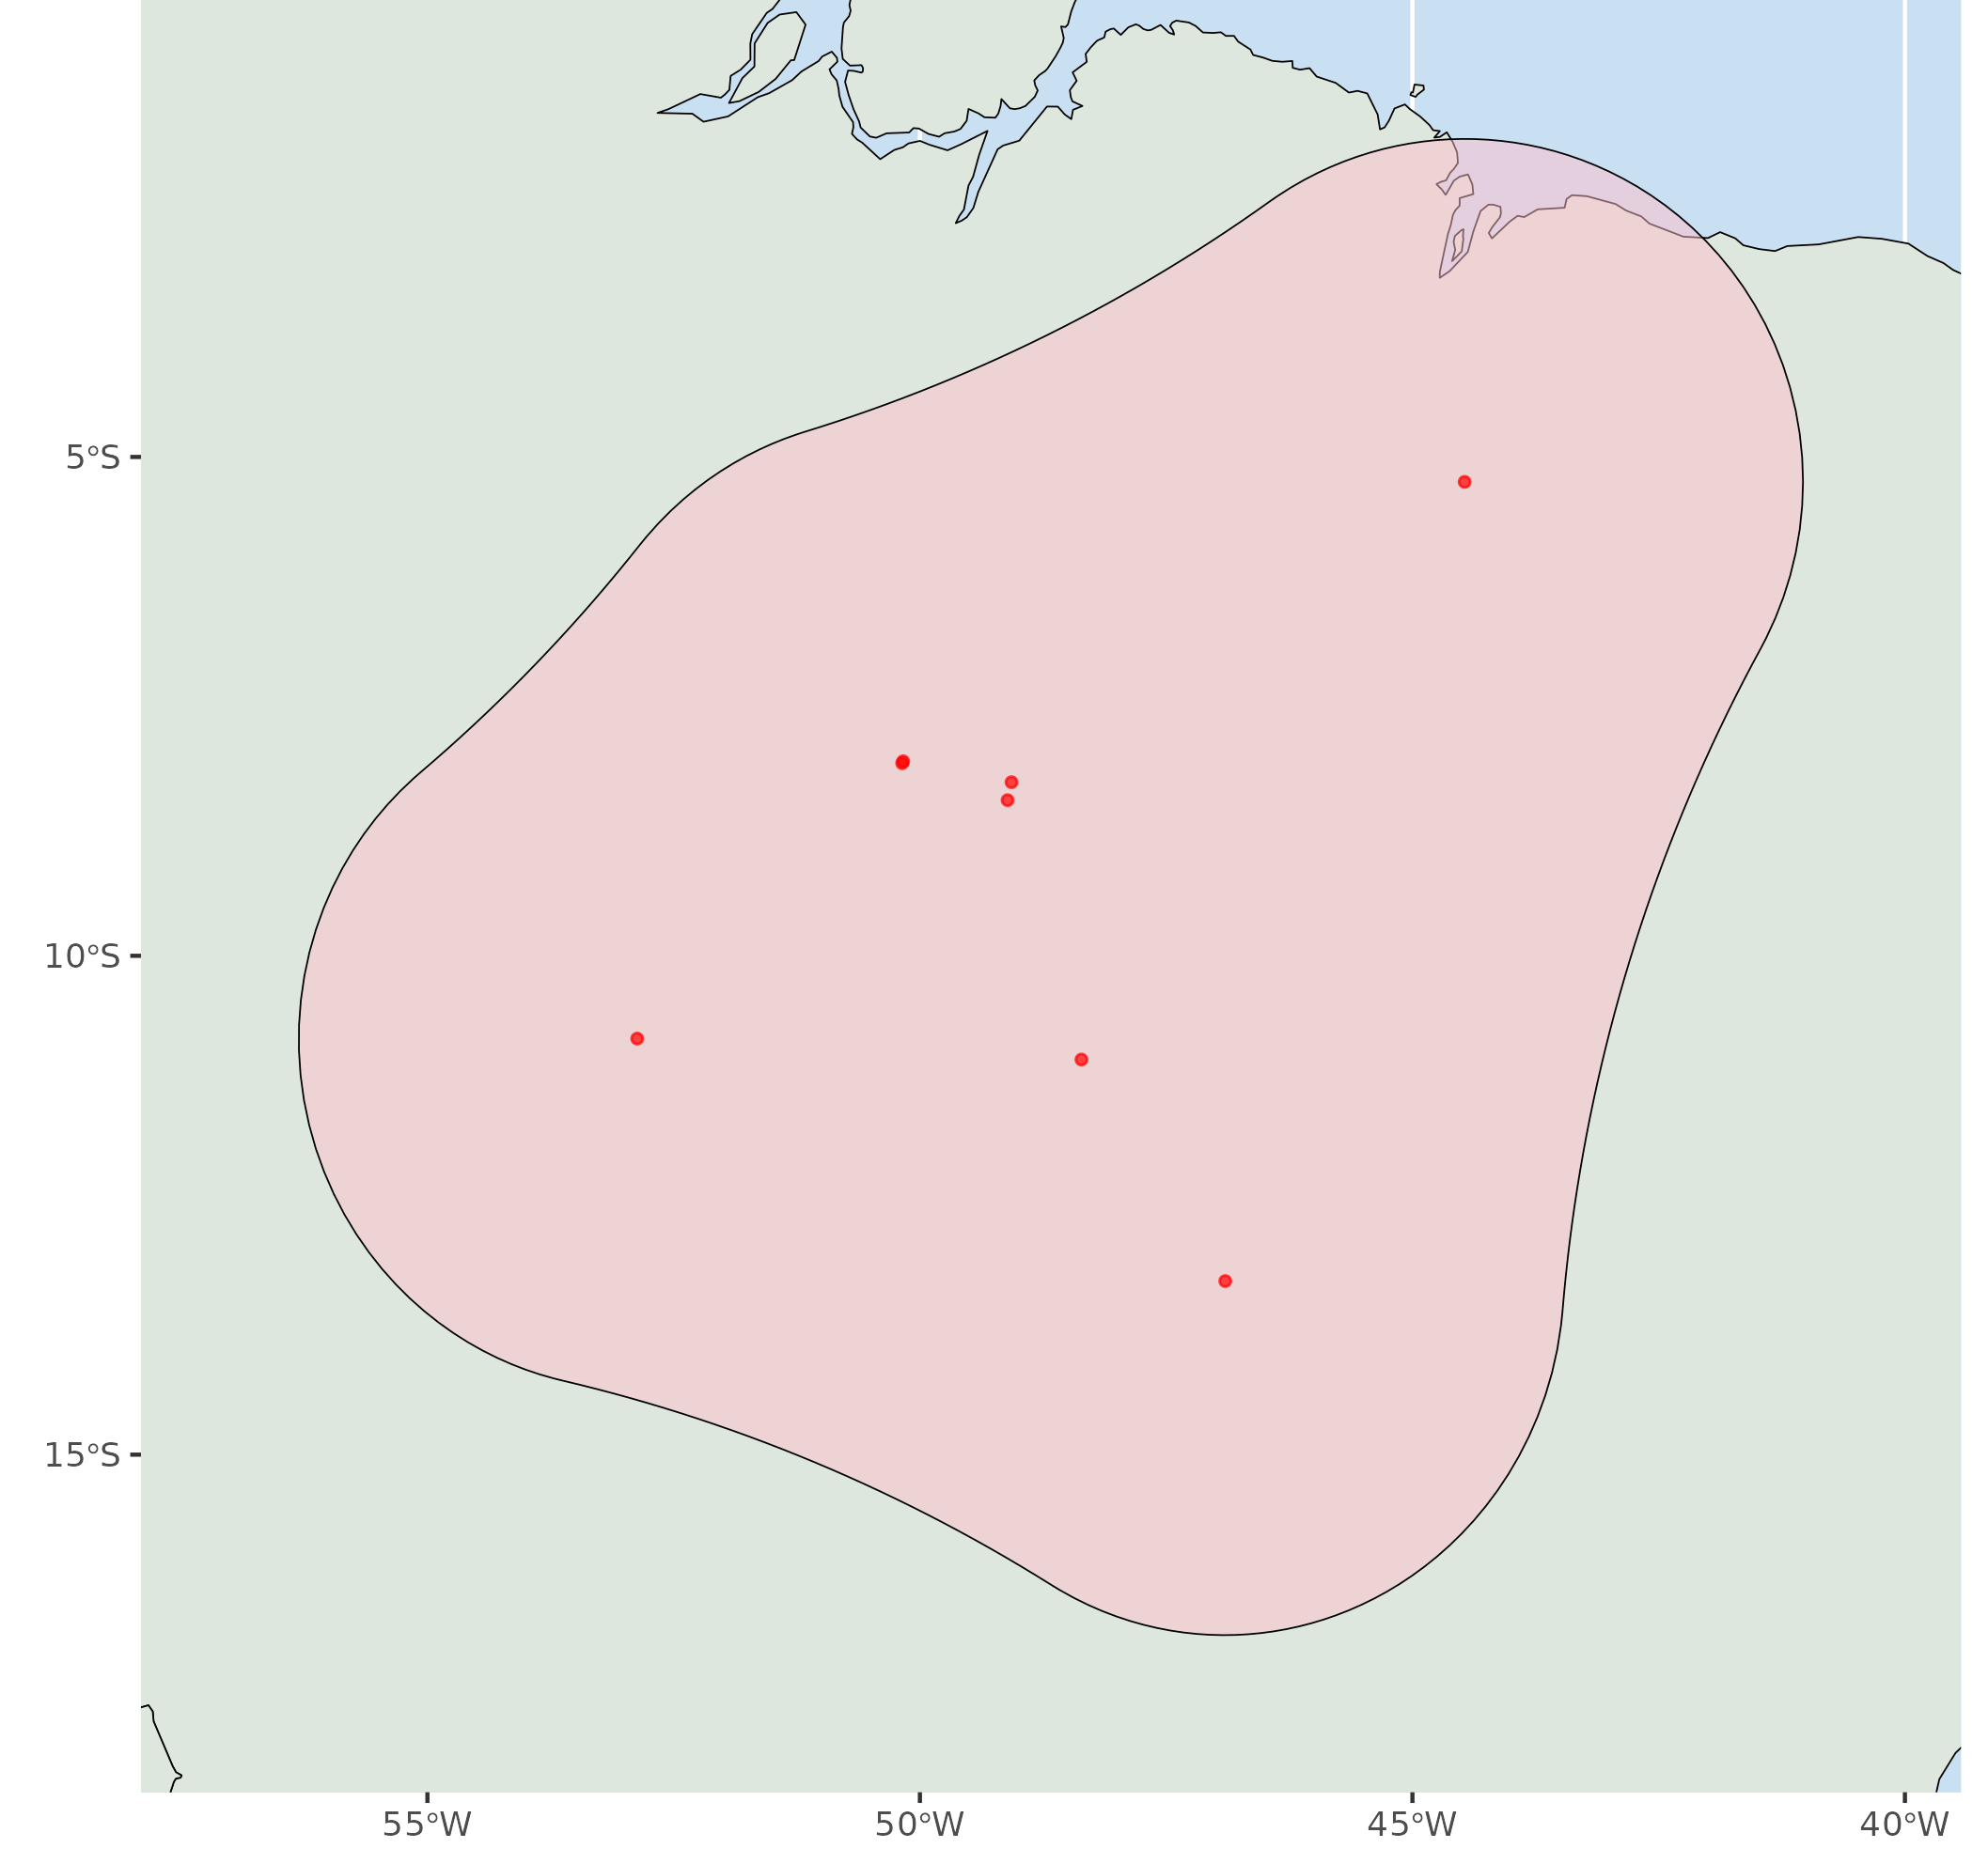
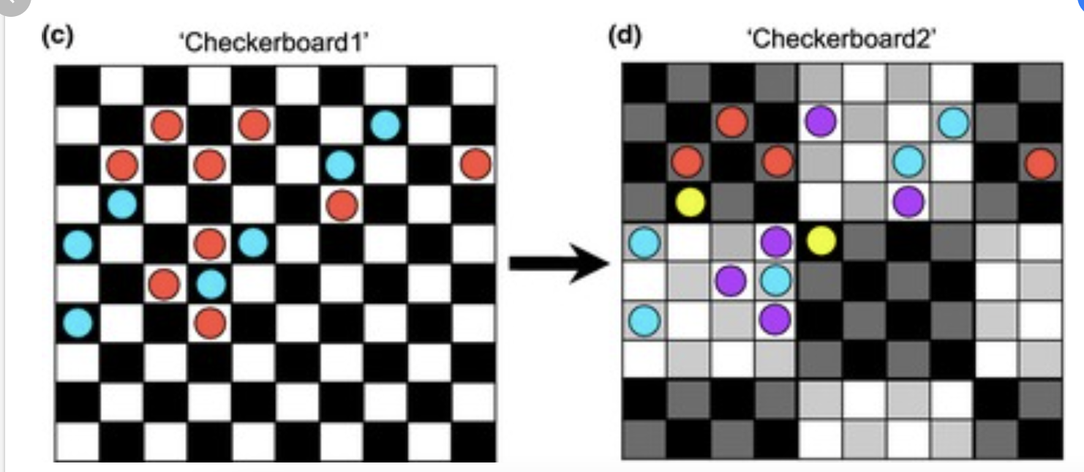
ENMeval: Partitions
Jackknife
Testing
Training
Training
Training
Testing
Training
Notes:
There are other options for partitioning methods like checkerboard which separate the study extent into a grid of either training or evaluation cells or jackknife which is useful when you have very little occurrence data as it’ll train on every presence minus one tester point and then cycle this process for each occurrence record

Slide 12
ENMeval: Feature Classes
Linear
Quadratic
Hinge
Combination
Suitability
Suitability
Suitability
Suitability
Environmental Variable
Environmental Variable
Environmental Variable
Environmental Variable
Notes:
Now, I mentioned tuning settings and that comes in the form of two parameters, feature class and regularization multipliers
Feature classes dictate the relationship between variable value and species suitability
A linear feature class implies a direct relationship, for instance, as temperature rises so does the probability of a species occurrence. Or it could work in the opposite way, as temperature increases, the probability of a species occurrence decreases
A quadratic feature class implies there’s ideal intermediate value of species suitability, maybe a species doesn’t like it too hot or too cold, but just in the middle is perfect
Those are the two we’re going to use today, but there’s definitely more, like hinge feature class which imply there are inherent thresholds to species suitability. Only after a certain value is reached, then we can see a change in suitability
ENMeval allows us to create models that employ every permutation of these feature classes, which can result in complex relationships where feature classes combine to form these funky response curves that are really good at predicting suitable areas for our species within the training data, but not the wider world which is a phenomenon called overfitting

Slide 13
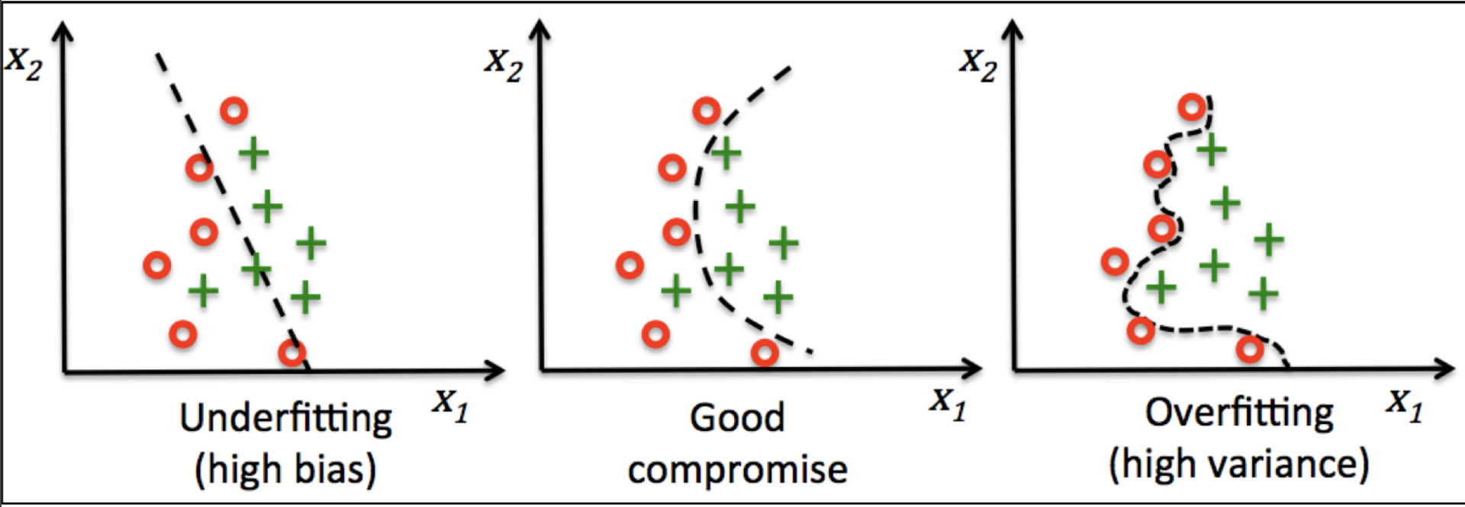
ENMeval: Regularization Multiplier
Complexity Penalization
RM too high!
RM too low!
Notes:
So while the predictors underlying our ENM are really good at working within the study extent, when applied to a more general area they falter because they ignore the overarching patterns that dictate species distributions
So how do we solve this?
Well, that comes in the form of our regularization multiplier, which penalizes our model for being too complex, ensuring that we don’t end up with a crazy specific response relationship
The higher it is, the more the model gets punished for complexity, and the lower it is the more it lets the model fit to the data
It’s with these two metrics that we fine tune the relationships between our environmental variables and species suitability scores

Slide 14
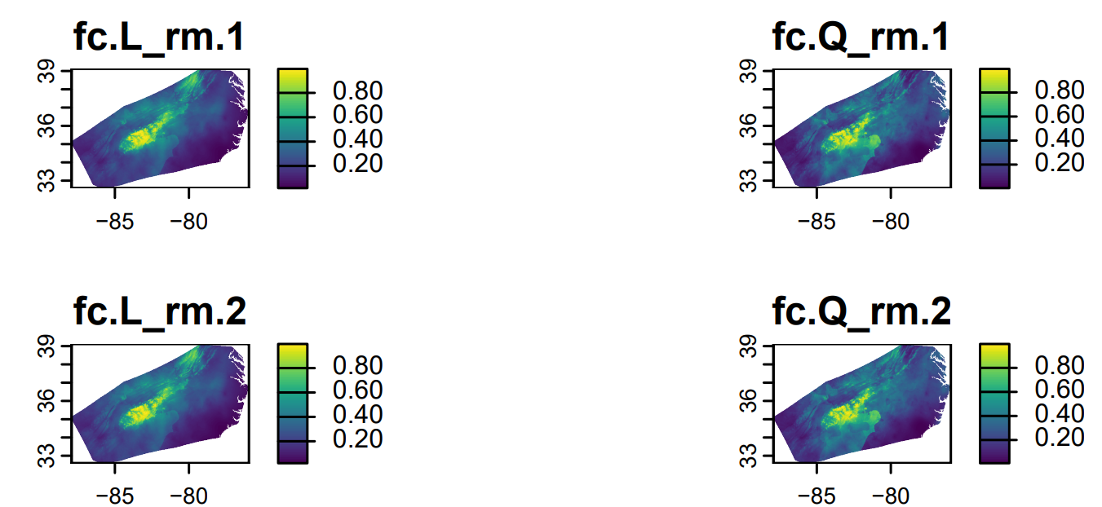
ENMeval: Models
Complexity Penalization
RM too high!
RM too low!
Notes:
In todays workshop we’re looking at only 2 randomization multiplier values, 1 and 2, and just the linear and quadratic feature classes, no combination of the two
So, ultimately end up with 4 newly generated models, but how do we determine which model is ideal for predicting our species fundamental niche?

Slide 15
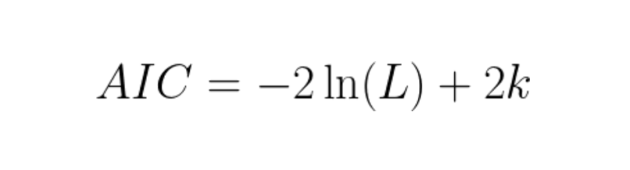
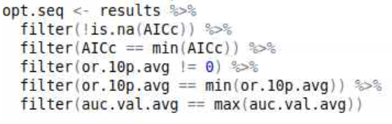
ENMeval: Model Evaluation
Akaike Information Criterion
Maximum likelihood of model
# of feature coefficients
Low AIC = Better Model Fit + Less Overfitting
Notes:
We begin by examining the models in relation to each other using the Akaike Information Criterion
It measures the relationship between how complex each model is and how well it fits to our data
The more parameters in a model, the higher the k, the higher the chance for overfitting and the worse the AIC score
So ideally, we want to find which model that has the lowest AIC

Slide 16
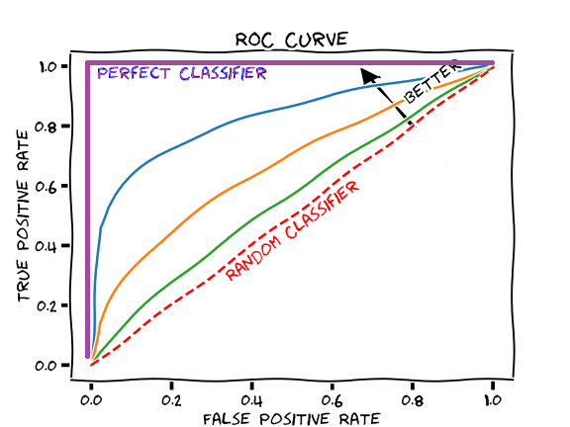

ENMeval: Model Evaluation
Area Under the Curve (AUC)
Omission Rate (OM)
Omitted
Approved
Lowest scoring training data point
AUC > 0.5 is ideal
OM close to 0 is ideal
OM = 0 is an overfit model
Notes:
Then we look at area under the curve, a metric that scores how well our model distinguishes between predicting where occurrences and background points are
In other words, if you take an occurrence point and a background point, and ask the model to assign a higher suitability to one of them, AUC is the probability that it will assign a higher score for the occurrence point
The closer to 1 it is, the better your model is at predicting suitable areas for occurrence records
While omission rate looks at the number of known occurrence records that your model says are growing in “unsuitable locations”
The more confirmed records that are growing in areas that your model deems as not highly suitable, the higher the omission rate
In that case, a rate closer to zero is ideal, but keep in mind that omission rate equal to 0 can indicate an overfit model

Slide 17
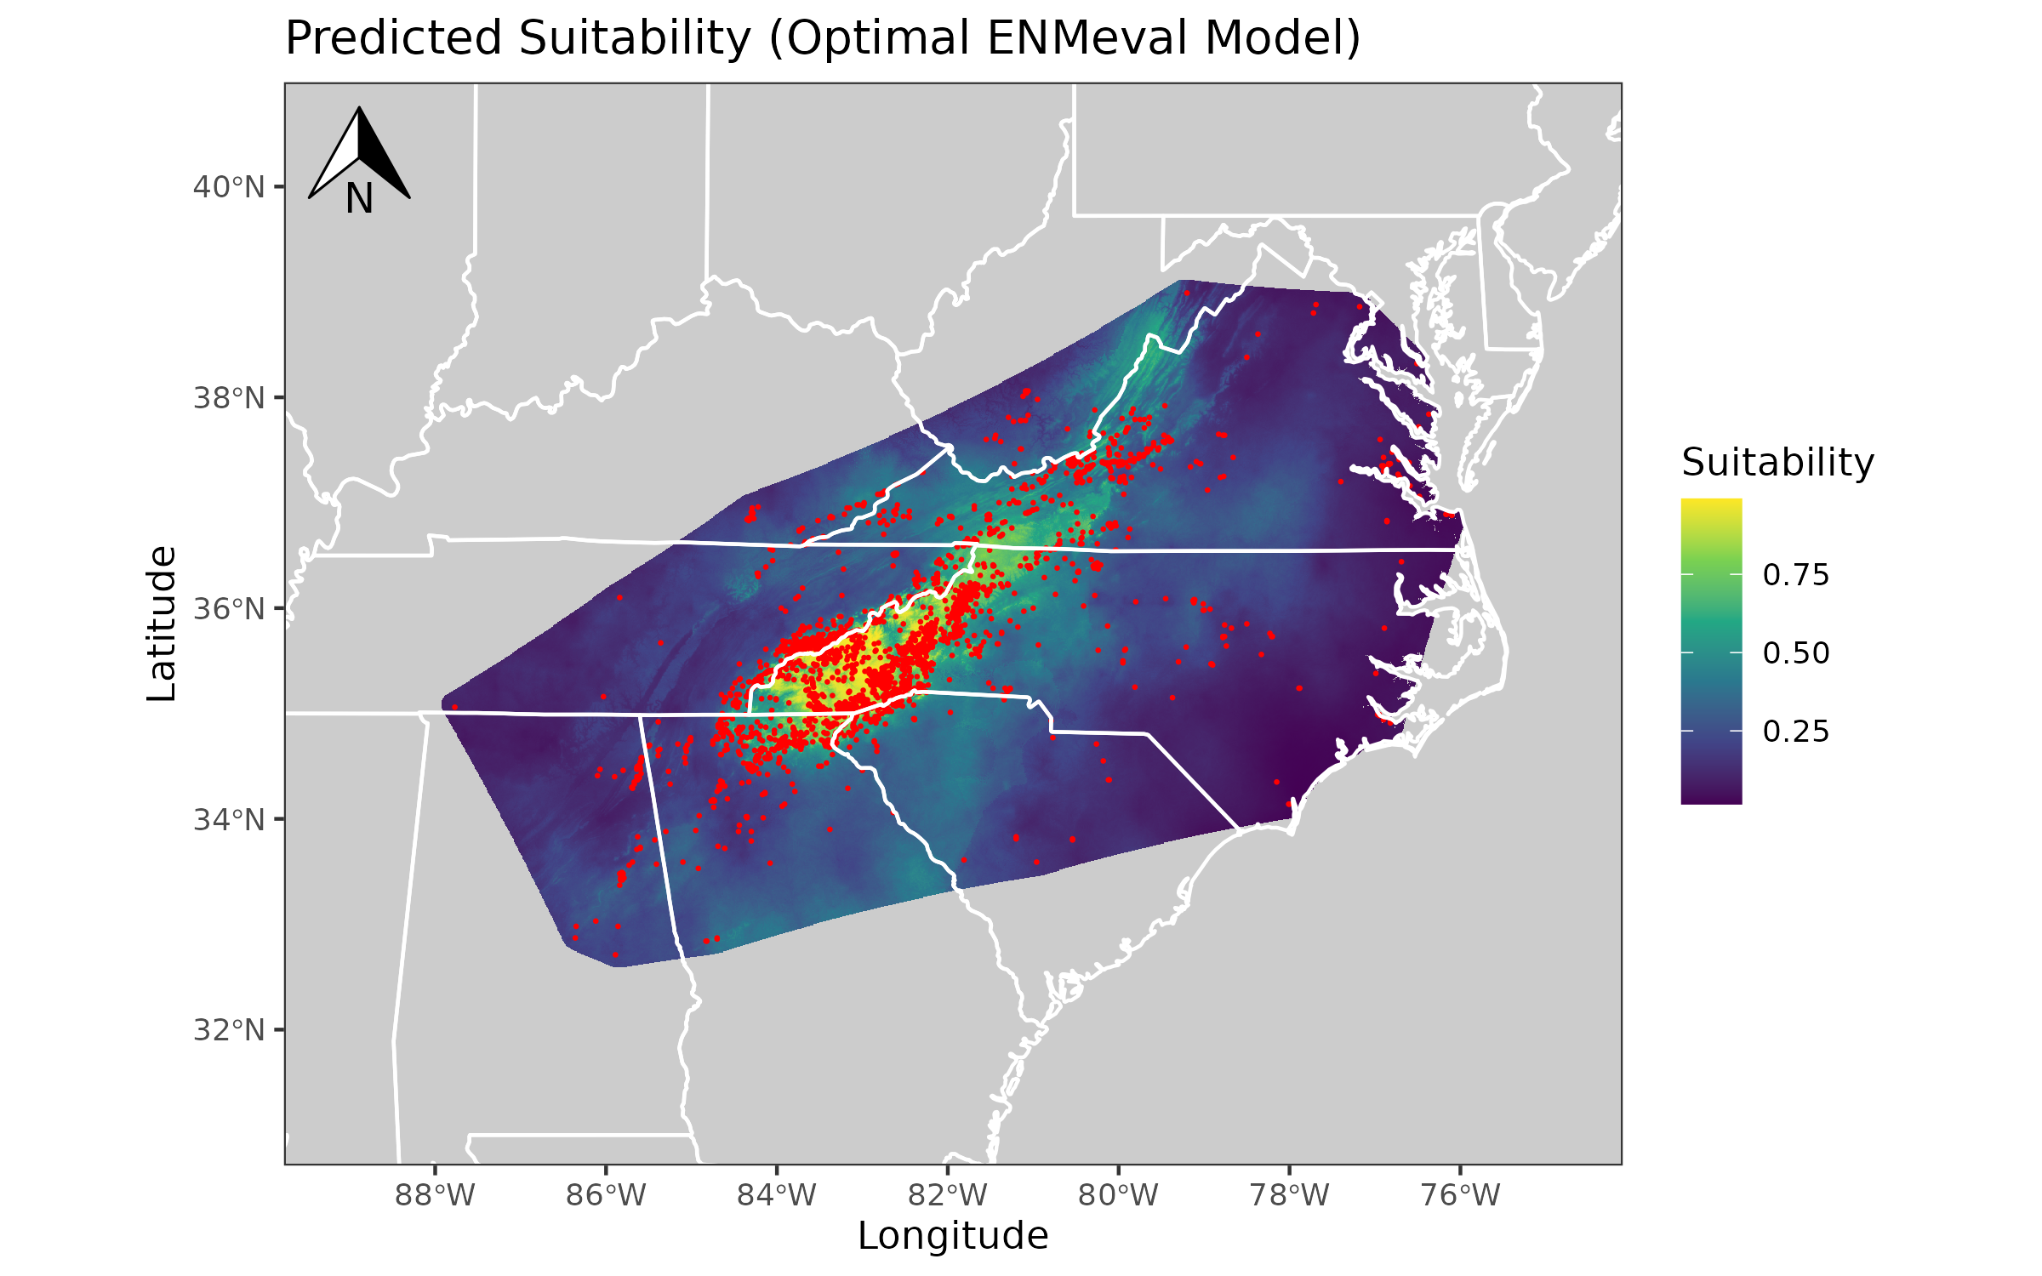
ENMeval: Optimal Model
Lowest AIC
Lowest OM
Highest AUC
Notes:
So after generating all our models, finding who’s got the lowest AIC, lowest OM, and highest AUC we can settle on our optimal model, the model that is best suited for our dataset
For galax urceolata, that turns out to be one with a regularization multiplier of 1 and linear feature classes

Slide 18
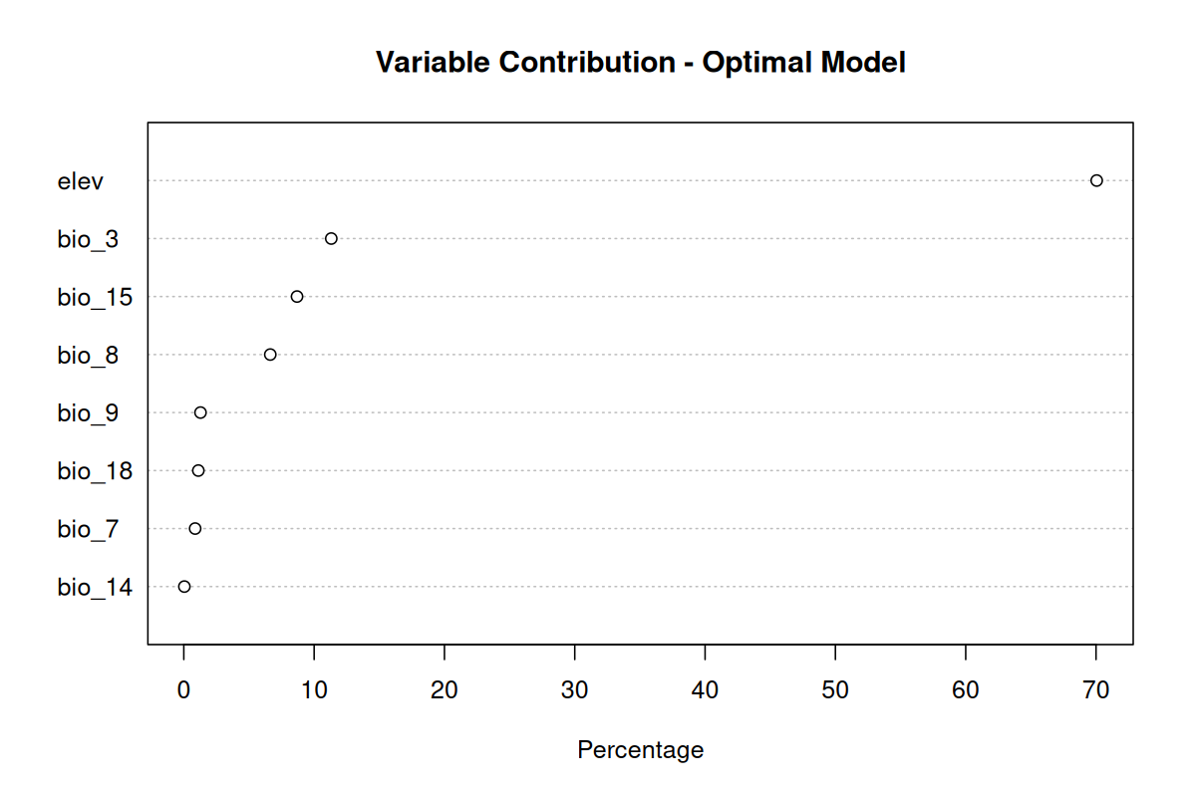
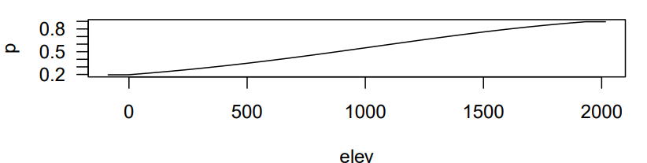
ENMeval: Optimal Model
Notes:
THis is what we’ll be using to make assumptions about our that species
And once its generated, we can look in its guts and examine what variables contribute most predicting suitability, and how their particular responses drive that up or down.
You can see here that elevation is one of the highest contribution variables to this suitability prediction
And looking at the response curve, as elevation increases, so does the probability of a species occurrence
And that’s it! Lets make some models!

